Slide 1
SVG Animation
Front-End Web Development

Slide 2
So, What Is an SVG?
Front-End Web Development

Slide 3

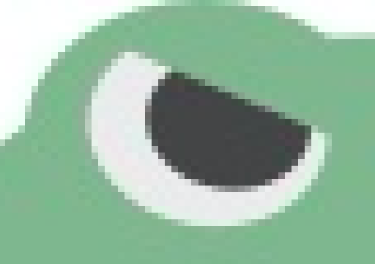

Pixels vs. Vectors
Pixels (JPGs, PNGs)
Vectors (SVGs)

Slide 4
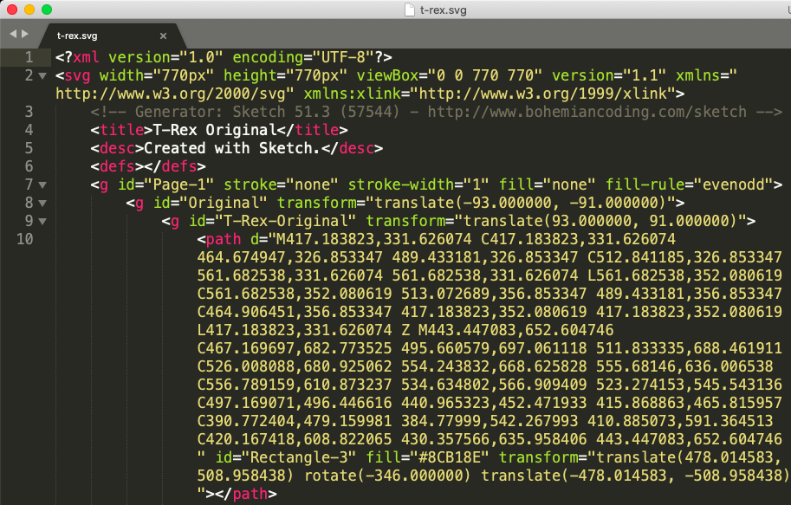
SVG: Scalable Vector Graphic
Made of shapes, not pixels.
Works on the web (unlike EPS).
Scales well.
Very small file size.
Written in code.
You can access individual items.

Slide 5
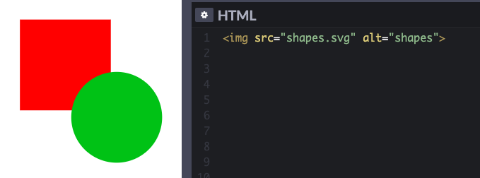
You Can Use SVGs in <img> Tags
But to access individual parts...

Slide 6
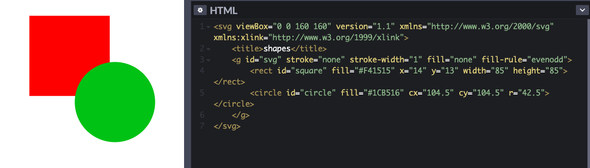
...Paste the SVG Code Directly Into Your HTML
Look at those IDs in the code. Now you can animate individual parts of the SVG!

Slide 7
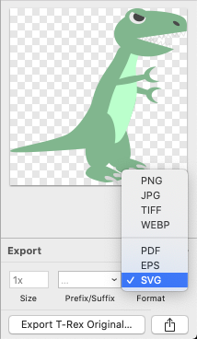
Side Note: Wait, Did You Write That SVG Code Yourself?!
No, you export the image as an SVG and the drawing program — Adobe Illustrator, Sketch, Figma, etc. — mcreate the code for you. (Or get one from Google or your illustrator friend.)

Slide 8
Ball Toss
Let’s try an SVG animation together! We’ll take an SVG and learn how to apply animation to individual parts.
Starter code:
https://codepen.io/ostrichreport/pen/vYLeymo
Solution code:
https://codepen.io/ostrichreport/pen/yLezVNb

